Slide 1
Labor force – education effect

Slide 2
agenda
INTRODUCTION
Join data sets
Calculation
Story & Dashboards

Slide 3

Introduction Education and labor force statistics provide crucial insights into a nation's socio-economic landscape, reflecting both its human capital development and economic performance. In this analysis, we explore the relationship between education indicators and labor force characteristics in France and the United Kingdom.

Slide 4


Join data sets

Slide 5
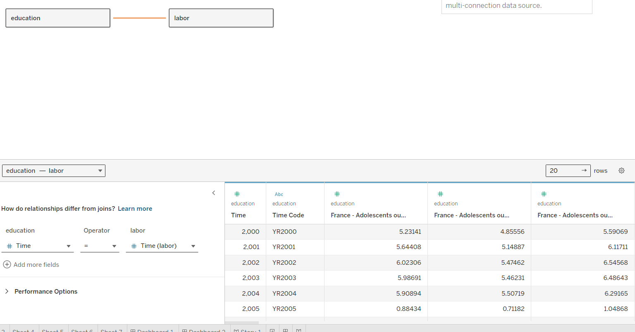
This merged dataset allows for a comprehensive analysis of the relationship between education and labor force characteristics in France and the United Kingdom over time.

Slide 6
calculations

Slide 7

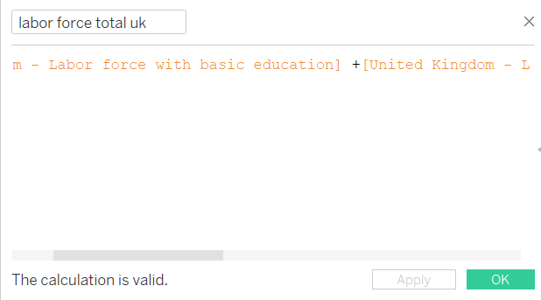
I used tableau to create group of time so I can calculate the change over period of time for some indicators
I also calculated the total labor force to use in in my calculation

Slide 8
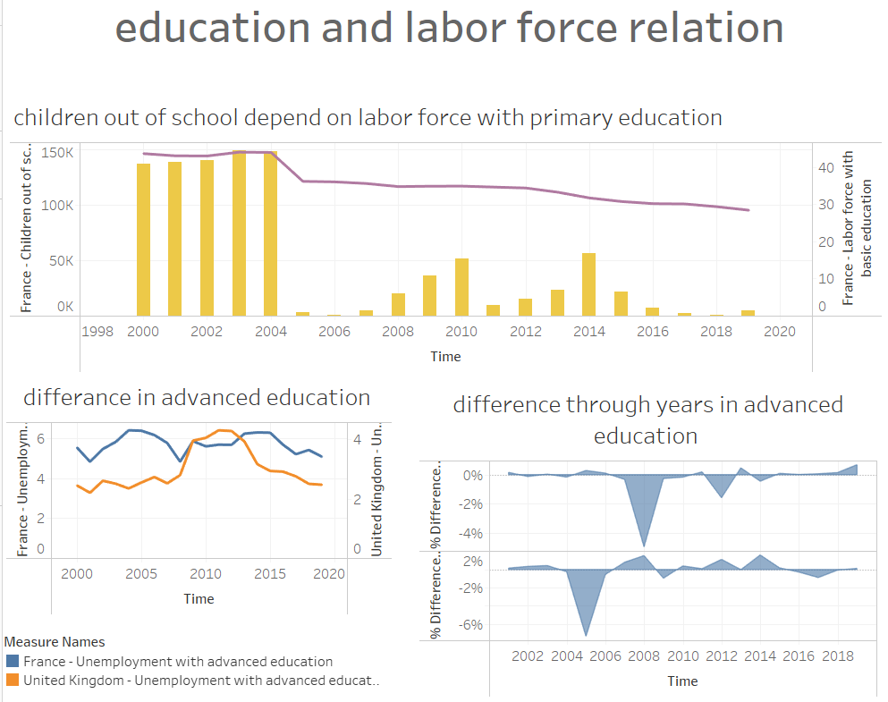
Dashboards 1

Slide 9
Story
First dashboard
France and the United Kingdom have made significant progress in reducing the number of children out of school from 2000 to 2019, but challenges remain in connecting education to the labor force.
While both nations increased the proportion of their labor force with advanced education, the unemployment increase during 2008-2013 due to Financial crisis in Europe.
France and the UK both experienced a steady increase in the proportion of the labor force with advanced education, but the gap between the two nations persisted, emphasizing the importance of investing in higher education and skill development for future economic prosperity.

Slide 10
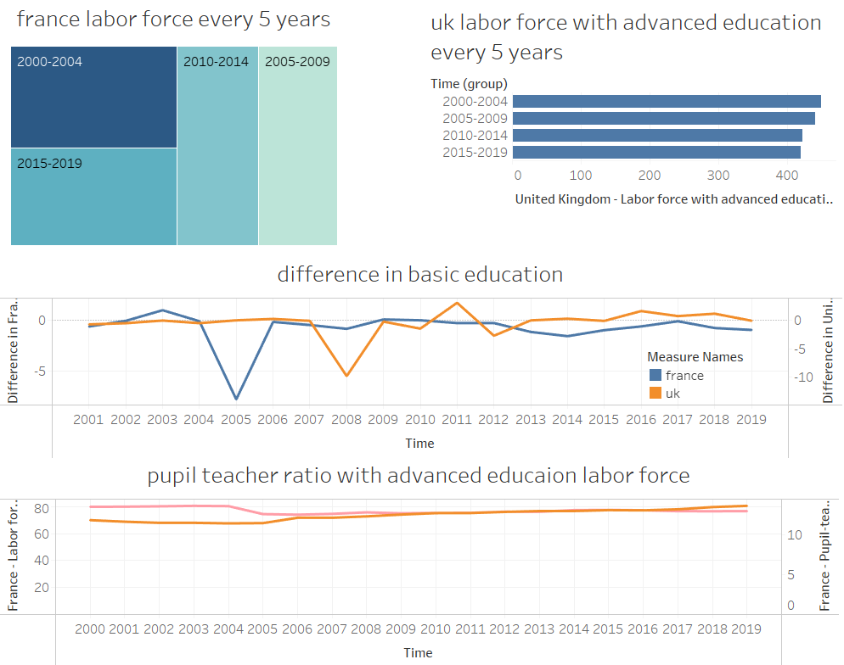
Dashboards 2

Slide 11
Story
second dashboard
Chart 1: Labor Force Evolution in France (Every 5 Years)
In France, the evolution of the labor force every five years reflects a steady growth. As the years progressed, so did the workforce, indicating sustained economic growth and stability.
Chart 2: Labor Force Evolution in the UK (Every 5 Years)
Across the English Channel, the United Kingdom was also making strides in developing its workforce. Similar to France, the UK's labor force witnessed continuous growth over the past two decades, signaling economic stability and development.
Chart 3: Difference in Basic Education Labor Force between France and the UK
Despite the continuous progress in both countries' labor forces, a gap emerged between France and the UK in terms of the basic education workforce. This underscores the need for sustained investments in basic education to ensure a qualified and skilled workforce.
Chart 4: Pupil-Teacher Ratio in Advanced Education Labor Force
Examining the pupil-teacher ratio in the advanced education labor force, we see how it directly impacts the number of students in advanced education. The higher the ratio, the more students are engaged in advanced education, reflecting both France and the UK's commitment to developing a skilled and proficient workforce.

Slide 12
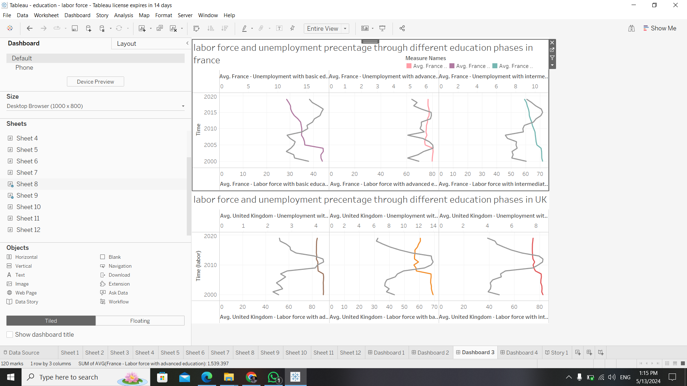
Dashboards 3

Slide 13
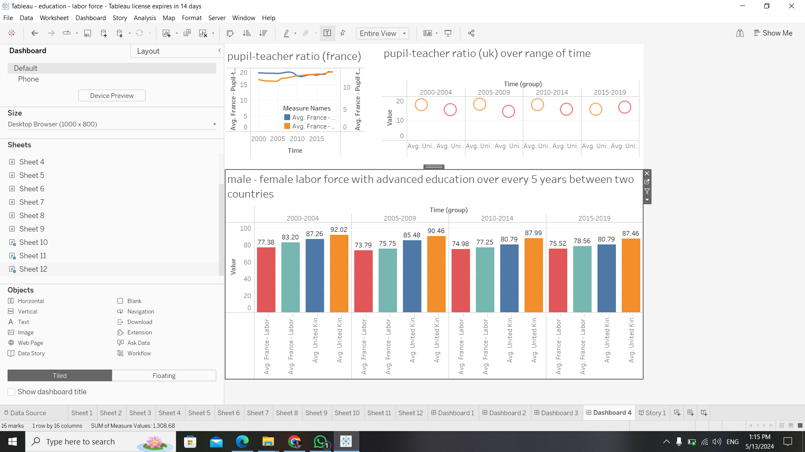
Dashboards 4

Slide 14
thank you

